Slide 1
Conceptual Framework
Prof. Arthur S. Abulencia

Slide 2
The definition of a conceptual framework

Slide 3
What is a conceptual framework?
A written or visual presentation that:
  “explains either graphically, or in narrative form, the main things to be studied – the key factors, concepts or variables -
  and the presumed relationship among them”.
  (Miles and Huberman, 1994)

Slide 4
Where the conceptual framework appears in the research

Slide 5
Where does the conceptual framework fit?
Preparing a conceptual framework can be likened to planning a holiday.
The purpose of the pre-planning of the holiday is to:
  Know how to get to, and return from, your holiday destination.
  Know what to do when you are at the destination.
  To be better prepared, and able to make the most of your holiday, because you can be guided by your previous experiences and by any information provided by others.
But is this pre-planning metaphor applicable to both quantitative and qualitative research in terms of the conceptual framework and the research process?

Slide 6
Where does the conceptual framework fit in - quantitative?
Research problem:
Paradigm:
Aims and objectives:
Literature review:
Conceptual framework:
Research questions:
Data collection and analysis:
Interpretation of the results:
Evaluation of the research:
The issue of theoretical or practical interest.
The philosophical assumptions about the nature of the world and how we understand it - positivism.
What we want to know and how the answer may be built up.
A critical and evaluative review of the thoughts and experiences of others.
Provides the structure/content for the whole study based on literature and personal experience
Specific questions that require answers.
Methodology, methods and analysis.
Making sense of the results.
Revisit conceptual framework.

Slide 7
Where does the conceptual framework fit in - qualitative?
Research problem:
Paradigm:
Aims and objectives:
Literature review:
Research questions:
Data collection and analysis:
Interpretation of the results:
Evaluation of the research:
The issue of theoretical or practical interest.
The philosophical assumptions about the nature of the world and how we understand it – e.g. interpretivism.
What we want to know and how the answer may be built up.
A critical and evaluative review of the thoughts and experiences of others.
Specific questions that require answers.
Methodology, methods and analysis.
Conceptual framework develops as participants’ views and issues are gathered and analysed.
Revisit conceptual framework.

Slide 8
Qualitative research - the position of the conceptual framework
Normally qualitative work is described as starting from an inductive position, seeking to build up theory, with the conceptual framework being ‘emergent’, because existing literature/theories might mislead.
However, Miles and Huberman (1994) note that:
  Researchers generally have some idea of what will feature in the study, a tentative rudimentary conceptual framework, and it is better to have some idea of what you are looking for/at even if that idea changes over time. This is particularly true for inexperienced and/or time constrained researchers.
  Qualitative research can also be confirmatory. Yin (1994), for example, identified pattern matching and explanation building. Pattern matching starts with existing theory and tests its adequacy in terms of explaining the findings. Explanation building starts with theory and then builds an explanation while collecting and analysing data.

Slide 9
Developing the conceptual framework

Slide 10
What inputs go into developing a conceptual framework?
Experiential knowledge of student and supervisor:
  Technical knowledge.
  Research background.
  Personal experience.
  Data (particularly for qualitative).
Literature review:
  Prior ‘related’ theory – concepts and relationships that are used to represent the world, what is happening and why.
  Prior ‘related’ research – how people have tackled ‘similar’ problems and what they have learned.
  Other theory and research - approaches, lines of investigation and theory that are not obviously relevant/previously used.

Slide 11
How might a conceptual framework be developed?
The pieces of the conceptual framework are borrowed but the researcher provides the structure. To develop the structure you could:
  Identify the key words used in the subject area of your study.
  Draw out the key things within something you have already written about the subject area – literature review.
  Take one key concept, idea or term at a time and brainstorm all the other things that might be related and then go back and select those that seem most relevant.
Whichever is used it will take time and a number of iterations and the focus is both on the content and the inter-relationships.

Slide 12
The presentation of the conceptual framework

Slide 13
What general forms might a conceptual framework take?
Process frameworks
  Set out the stages through which an action moves from initiation to conclusion. These relate to the ‘how?’ question.
Content frameworks
  Set out the variables, and possibly the relationship (with relative strengths) between them, that together answer the ‘why?’ question.

Slide 14
What specific forms might a conceptual framework take?
The possibilities include:
  Flow charts.
  Tree diagrams.
  Shape based diagrams – triangles, concentric circles, overlapping circles.
  Mind maps.
  Soft systems.

Slide 15
A ‘flow chart’ of innovation decision making
PRIOR CONDITIONS
Previous practice
Felt needs/problems
Innovativeness
Norms of the social system
COMMUNICATION CHANNELS
1. KNOWLEDGE
2. PERSUASION
3. DECISION
4. IMPLEMENTATION
5. CONFIRMATION
Observations of the
decision making unit
Socio-economic characteristics
Personality variables
Communication behaviour
Perceived characteristics
of innovation
Relative advantage
Compatibility
Complexity
Trialability
Observability
1. Adoption
Confirmed Adoption
Later Adoption
Discontinuance
Continued Rejection
2. Rejection
Rogers 2003

Slide 16
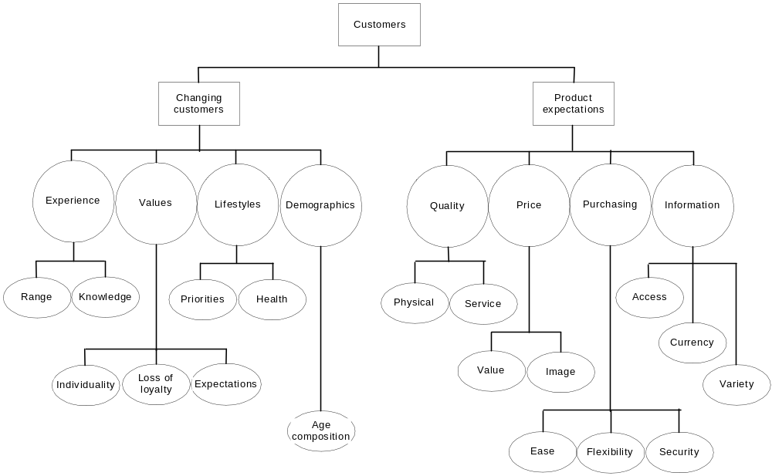
A ‘tree chart’ of changing consumer behaviour

Slide 17
A ‘triangle’ of needs
Self actualisation
Esteem
Affiliation
Security
Physiological
Maslow 1954

Slide 18
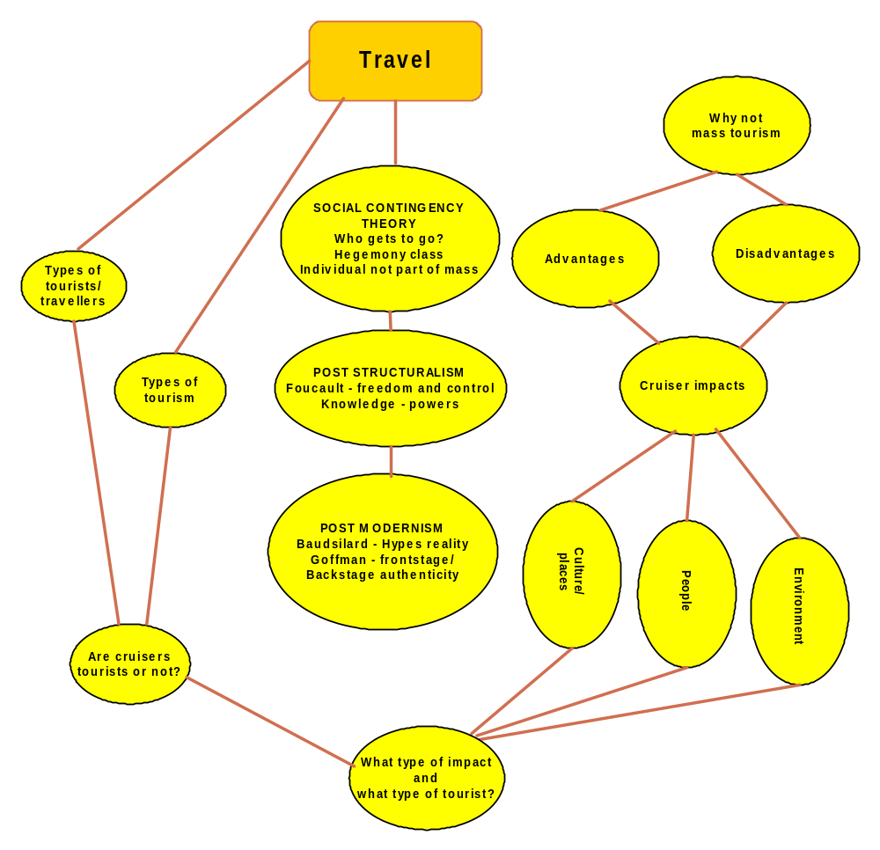
A mind map of cruise travel and impacts
Jennings 2001

Slide 19
Soft systems framework of tourism business activity
2
3
1
Process
Institutional
Environment
Business
Environment
Content
4
5
6
Output
Behaviour
Motivation
7
Outcome

Slide 20
The good and bad of conceptual frameworks

Slide 21
Why are conceptual frameworks useful?
Conceptual frameworks provide researchers with:
  The ability to move beyond descriptions of ‘what’ to explanations of ‘why’ and ‘how’.
  A means of setting out an explanation set that might be used to define and make sense of the data that flow from the research question.
  An filtering tool for selecting appropriate research questions and related data collection methods.
  A reference point/structure for the discussion of the literature, methodology and results.
  The boundaries of the work.

Slide 22
What are the limitations of a conceptual framework?
Conceptual frameworks, however, also have problems in that the framework:
  Is influenced by the experience and knowledge of the individual – initial bias.
  Once developed will influence the researcher’s thinking and may result in some things being given prominence and others being ignored – ongoing bias.
The solution is to revisit the conceptual framework, particularly at the end when evaluating your work.

Slide 23
The overall contribution of the conceptual framework
The conceptual framework encapsulates the research as it:
  Sets out the focus and content.
  Acts as the link between the literature, the methodology and the results (regardless of when in the PhD process it is produced).
Thus it can be/will be the focus/starting point of the evaluation of originality in terms of the criteria outlined by Hart (1998). For example:
  Is what has been focussed on entirely new?
  Is the way the subject been investigated different to the ‘normal’ approaches?
  Has new light been shed on previously explored issues?

